Slide 1


Effects of Developmental Adversity on Adult Musicality
Kelsie L. Lopez,* Nick Kathios,* Psyche Loui,^ and
Laurel J. Gabard-Durnam^
Notes:
Hello, I’m here to talk to you today about the effects of early life adversity on adult musicality. This is a collaboration between the Music, Imaging, and Neurodynamics Lab and the Plasticity in Neurodevelopment Lab in the Center for Cognitive and Brain Health at Northeastern University in Boston Massachusetts.

Slide 2





Early musical training confers both near and far transfer effects later in life
Bailey & Penhume, 2010; Kraus et al., 2009; Tierney et al., 2008; Schlaug et al., 1995; Hyde et al., 2009
Notes:
Existing literature suggests that early musical training confers both near and far transfer effects later in life. For example, early musical training is associated with improved pitch and rhythm perception and auditory memory. In addition, it’s associated with increases in corpus callosum volume and structural changes in auditory & motor areas.

Slide 3



Early musical training confers both near and far transfer effects later in life
Nguyen et al., 2023; Bailey & Penhume, 2010; Kraus et al., 2009; Tierney et al., 2008
Notes:
However, there is currently very little known about the flip side. Is it possible that the early life environment is also influential in affecting adult musicality? For example, how do environmental factors like early adversity, positive experiences, and caregiver parental interactions impact later musical abilities? In fact, a recent review from Nguyen et al., 2023 have also concurred that the early social environment's role in music development has been minimally investigated thus far. We hope to begin to fill this gap with the present research.

Slide 4
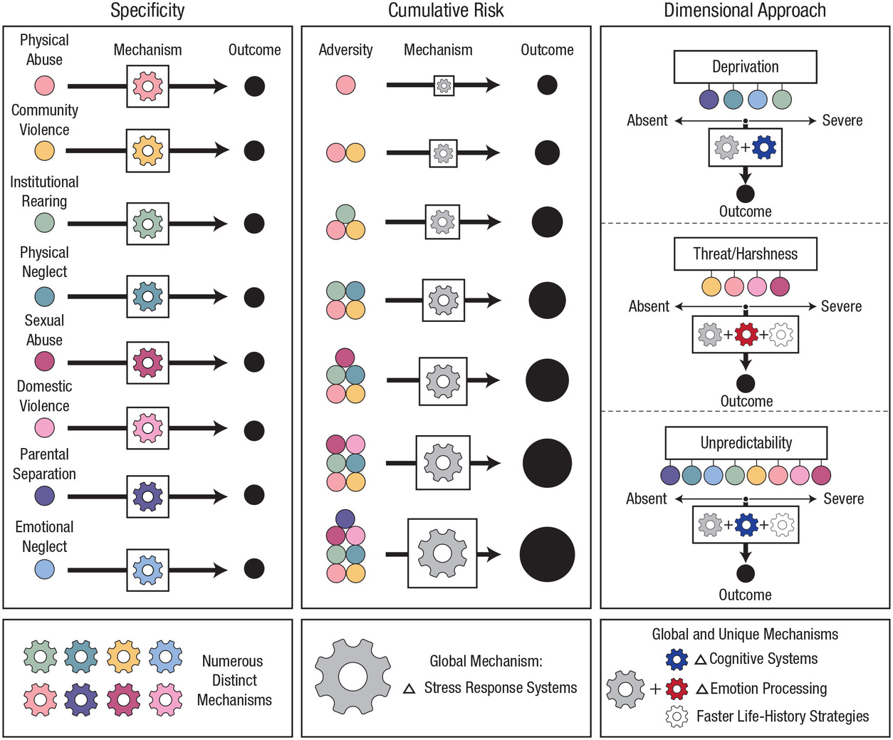
Dimensions of Early Adversity
McLaughlin et al., 2021
Notes:
As I mentioned before, one such type of experience that may be impacting musicality later in life is early adversity. Research on early adversity has a fairly long history, but we haven’t always conceptualized adversity in the same way. One way that adversity is conceptualized is by the specificity model. The specificity approach involves measuring adversity experiences individually (i.e., one at a time) and assumes that developmental mechanisms influenced by different forms of adversity are largely distinct with no overlap, which, as you’re probably thinking, is frequently not the case.

Slide 5
Dimensions of Early Adversity
McLaughlin et al., 2021
Notes:
Meanwhile, the cumulative-risk approach, which is probably the more well known model, involves counting the number of discrete adversity exposures and experiences, assuming that the effects of distinct adversities on developmental outcomes are equal and additive, which is also not true of all types of adversities. This is also known as the ACEs approach

Slide 6
Dimensions of Early Adversity
Deprivation: absence of expected environmental input
Threat: exposure to or risk of physical or psychological harm
Unpredictability: stochastic variation in environment
McLaughlin et al., 2021
Notes:
To address the limitations of the specificity and cumulative-risk approaches, dimensional models were developed. The dimensional approach identifies core dimensions of experience that occur in multiple types of adversity. It can be assessed continuously as a function of both the severity or chronicity of adversity experiences. The field has been moving toward this model because you can specify the developmental mechanisms most likely to be influenced by these aspects of experience, including some that are shared across multiple dimensions and others that are unique to certain dimensions.
The three dimensions of adversity are deprivation, defined as the absence of expected environmental input, threat, defined as exposure to or risk of physical or psychological harm, and unpredictability, defined as stochastic variation in environment. We will be taking this approach in the present study.

Slide 7




Early Life Adversity
Reward-Processing
Affect
Language
Novick et al., 2018
Boecker et al., 2014
Tottenham & Gabard-Durnam, 2017
Callahan & Tottenham, 2016
Sylvestre et al., 2016
Miller et al., 2020
Notes:
It’s the existing early adversity literature that motivates us to believe that it may have an impact on adult musicality. Early life adversity is currently implicated in affecting a number of domains that are closely related to musicality, such as reward-processing, affect, and language. For example, Boeker et al (2014) indicate a differential long-term impact of early life adversity on reward processing, implicating hyporesponsiveness during reward anticipation and hyperresponsiveness when receiving a reward. Meanwhile, Callahan and Tottenham (2016) indicate in a review that across numerous studies, early adversity leads to accelerated maturation of emotion circuits in the brain and in the behaviors supported by these regions. Finally, Sylvestre et al (2016) show that the language skills of children who have experienced abuse and/or neglect are delayed when compared to children who have not had these experiences. Taken together, early adversity has far reaching effects on many aspects of cognition and behavior, but currently little is known about its affects on musicality, leading us to our research question motivating the present study...

Slide 8
Does early adversity have long term effects on adult musicality?

Slide 9
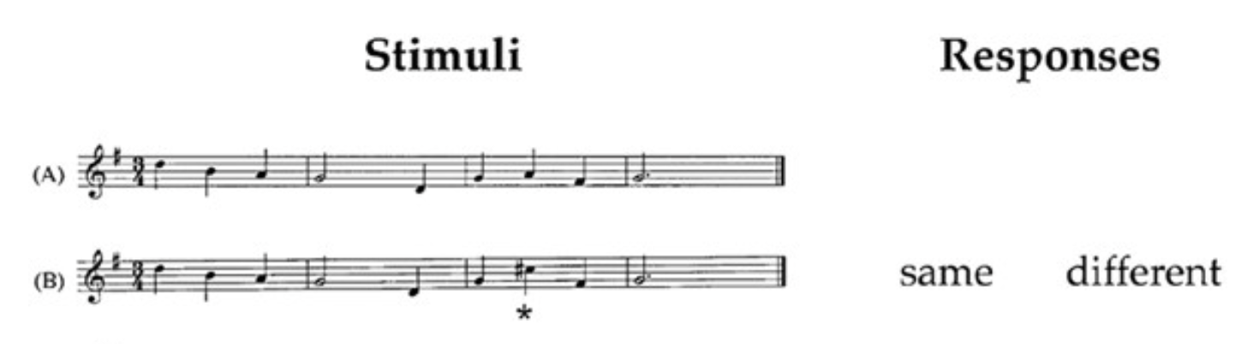
Study 1
N = 264 (143 F)
18-65 years
Montreal Battery of Evaluation of Amusia (MBEA)
(Scale Test 1; Peretz et al., 2003)
Cuddy et al., 2006
Notes:
To address this question, we carried out three different studies with three samples.
Using the online platform Prolific, in Study 1, we had 264 adult participants between the ages of 18-65 years from a previous study in our lab complete the Montreal Battery of Evaluation of Amusia. The MBEA is a screening tool for congenital amusia that assesses a variety of mechanisms that underlie musicality over a series of 6 tests. For the purposes of the first study, participants completed MBEA 1, known as the scale test. The scale test measures the perception of musical scale information - or tonality. Participants listen to two versions of a melody and have to indicate whether the second is the same or different than the first. The “different” comparisons use notes from outside the tonal key that is established by the notes of the melody.

Slide 10


Retrospective Report Adversity Questionnaires:
Questionnaire of Unpredictability in Childhood
(QUIC; Glynn et al. 2019)
Confusion, Hubbub, and Order Scale
(CHAOS; Matheny et al., 1995)
McLaughlin Deprivation and Threat Scales
(McLaughlin et al., 2014)
Unpredictability
Auditory commotion
(type of unpredictability)
Deprivation
Threat
Childhood
6-12 years
Adolescence
13-18 years
Notes:
In addition to the MBEA, participants completed four questionnaires that measured retrospective reports of adversity.
To measure general unpredictability, we used the Questionnaire of Unpredictability in Childhood. "At least one of my caregivers had punishments that were unpredictable."
Another type of unpredictability known as auditory commotion in the home was measured using the 6-item short form Confusion, Hubbub, and Order Scale. "It was so noisy, you couldn't hear yourself think in our home."
Both deprivation and threat were measured using the McLaughlin Deprivation and Threat scales. "How often did you not have regular meals to eat?" "How many times did an adult push, grab, slap, or throw something at you when you were an child/adolescent?”
Importantly, we measured retrospective reports of adversity during two time points: childhood (6-12 years) and adolescence (13-18 years).
In addition, to serve as covariates in our models, participants completed the Goldsmith Musical Sophistication Index, The Trait subscale of the State/Trait Anxiety Index, and the Physical Anhedonia Scale. We covary for musical training because of it’s known positive effects on musicality and musical ability, but we additionally included measures of anxiety and depression to control for the effects of adversity on mental health outcomes.

Slide 11
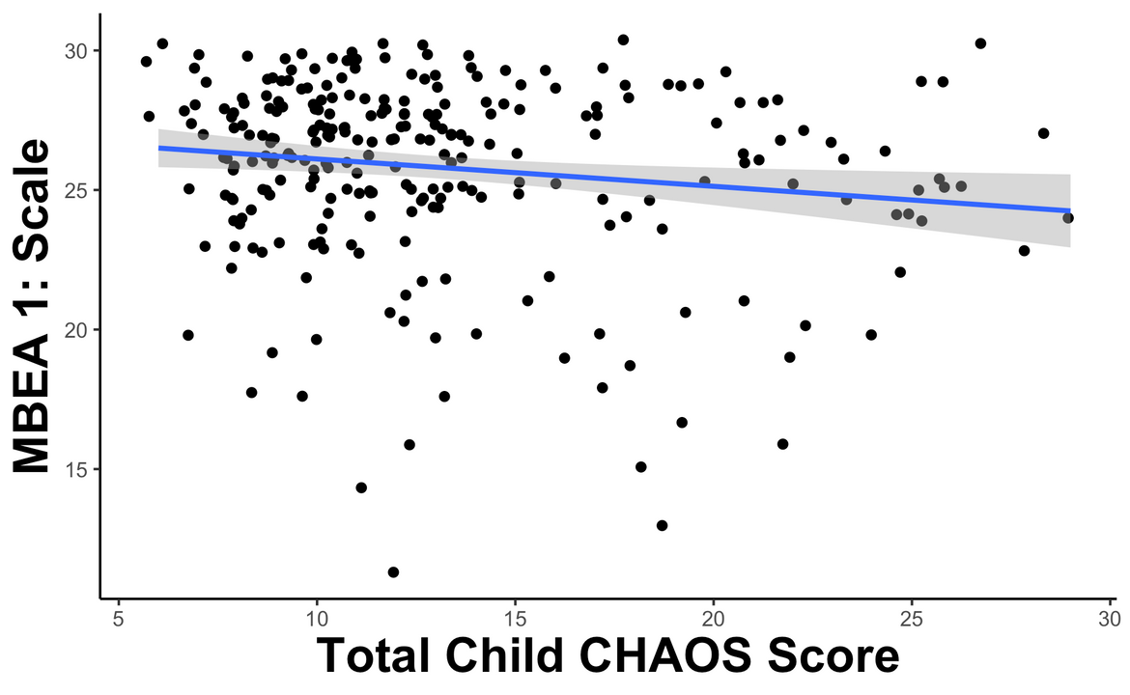
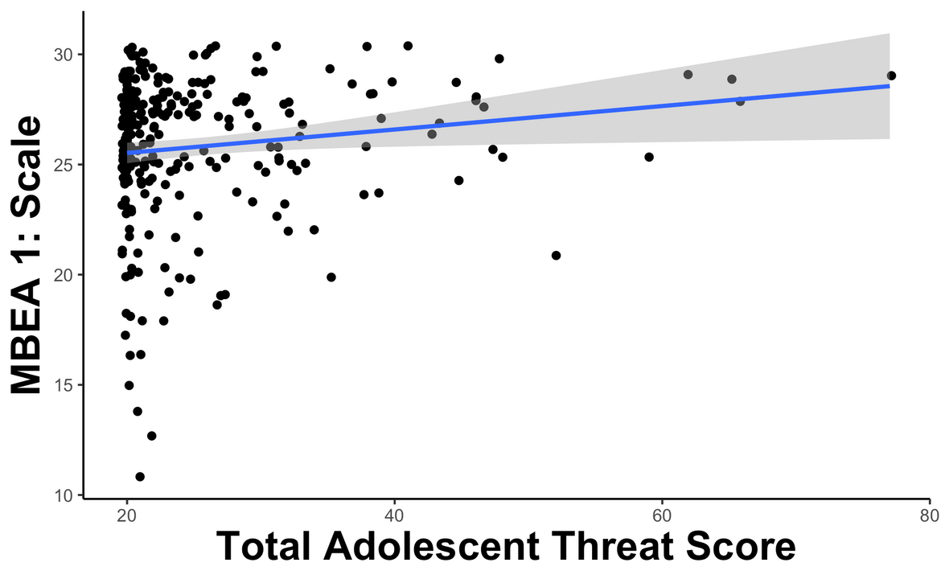
Childhood auditory commotion is associated with lower scores on MBEA 1 while adolescent threat is associated with higher scores
r = -0.15, p = .01
r = -0.14, p = .02
Notes:
Correlating the adversity dimensions and MBEA scores revealed that Childhood auditory commotion is associated with lower scores on MBEA 1 while adolescent threat is associated with higher scores

Slide 12
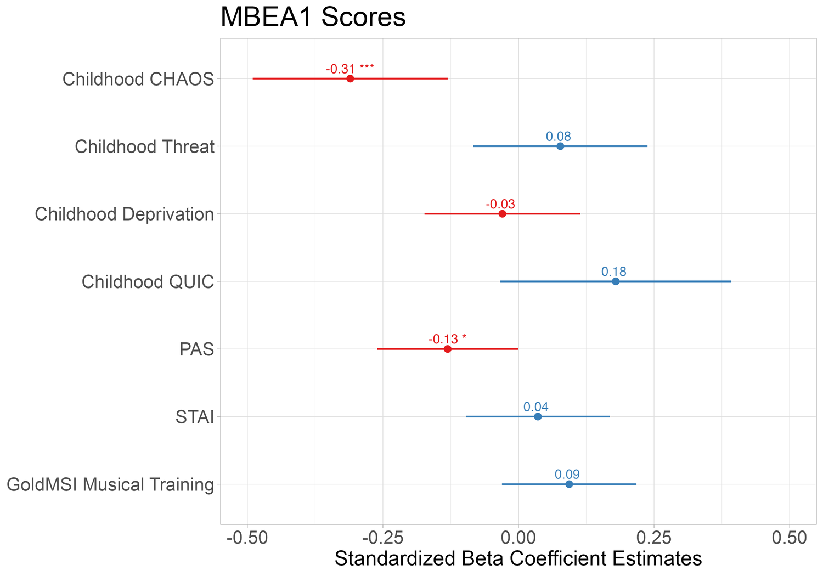
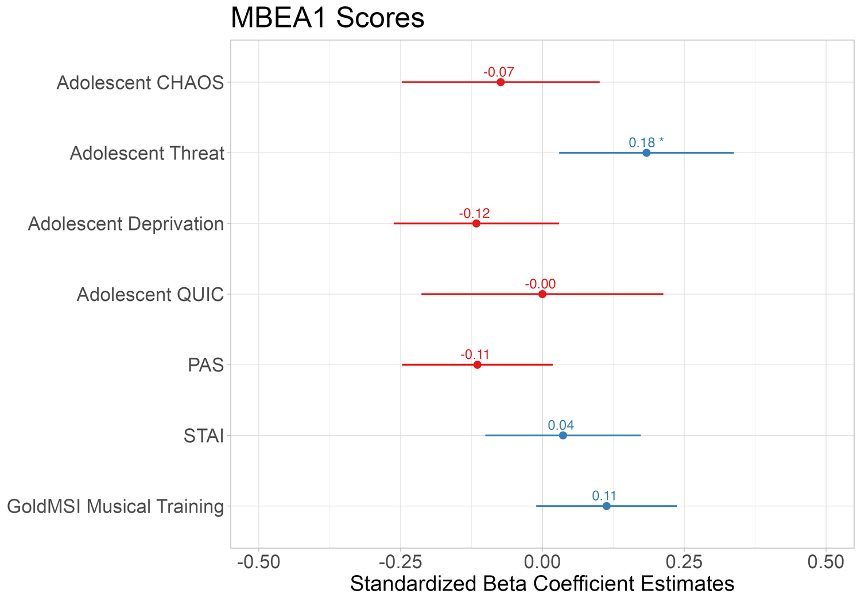
Over and above other dimensions of adversity, musical training, and current mental health outcomes
Notes:
These effects persisted when controlling for musical training and mental health outcomes. However, the adolescent threat finding did not survive corrections for multiple comparisons.
Further, a model with measures of CHAOS and threat at both time points revealed the importance of adversity timing, as only childhood CHAOS was significantly related to MBEA scores over and above covariates.

Slide 13
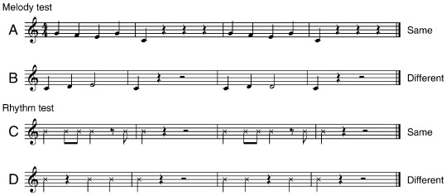
Study 2
N = 288 (141 F)
18-65 years
Musical Ear Test (MET)
(Wallentin et al., 2010)
Notes:
Given these findings, we decided to probe further with a second study to see whether these findings would hold for a more difficult test of musicality in another sample. We once again recruited adults on Prolific from another previous study in our lab. 288 adults between 18-65 years completed the both the melody and rhythm tests of the Musical Ear Test. This test was designed for measuring musical abilities in both musicians and non-musicians. It notably spreads out scores on the upper end.
It consists of 104 trials on which participants judge whether two short musical phrases are identical or not. The melodic subtest contains 52 pairs of melodic phrases, played with sampled piano sounds while the rhythm subtest contains 52 trials with rhythmical phrases, played with wood block sound.
Participants also completed the same adversity, mental health, and musical training questionnaires as Study 1, with the exception of the CHAOS, which now included the full 15-item scale.

Slide 14
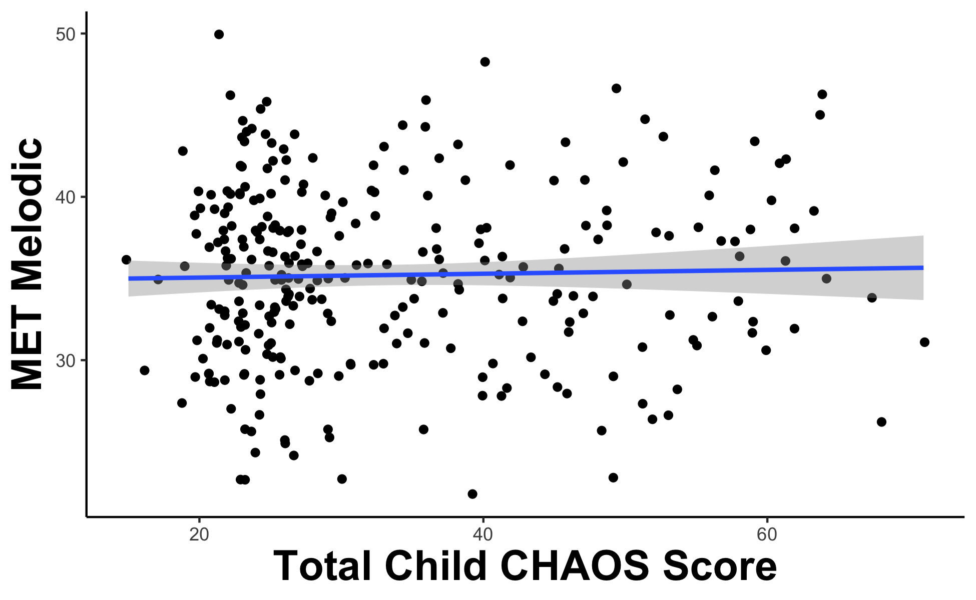
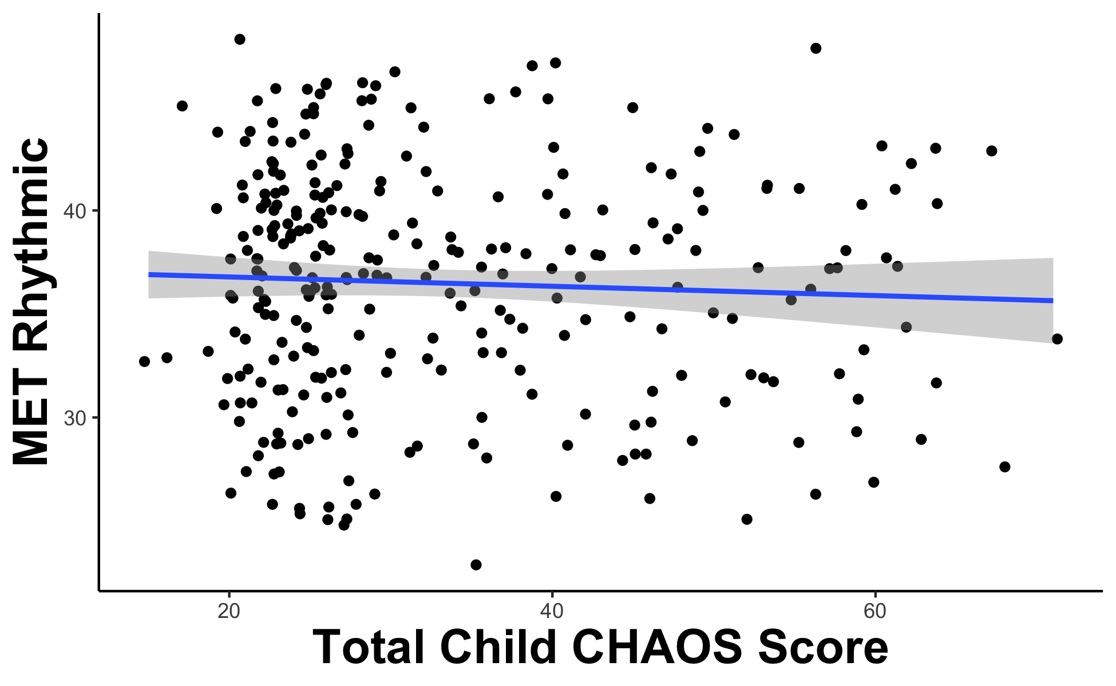
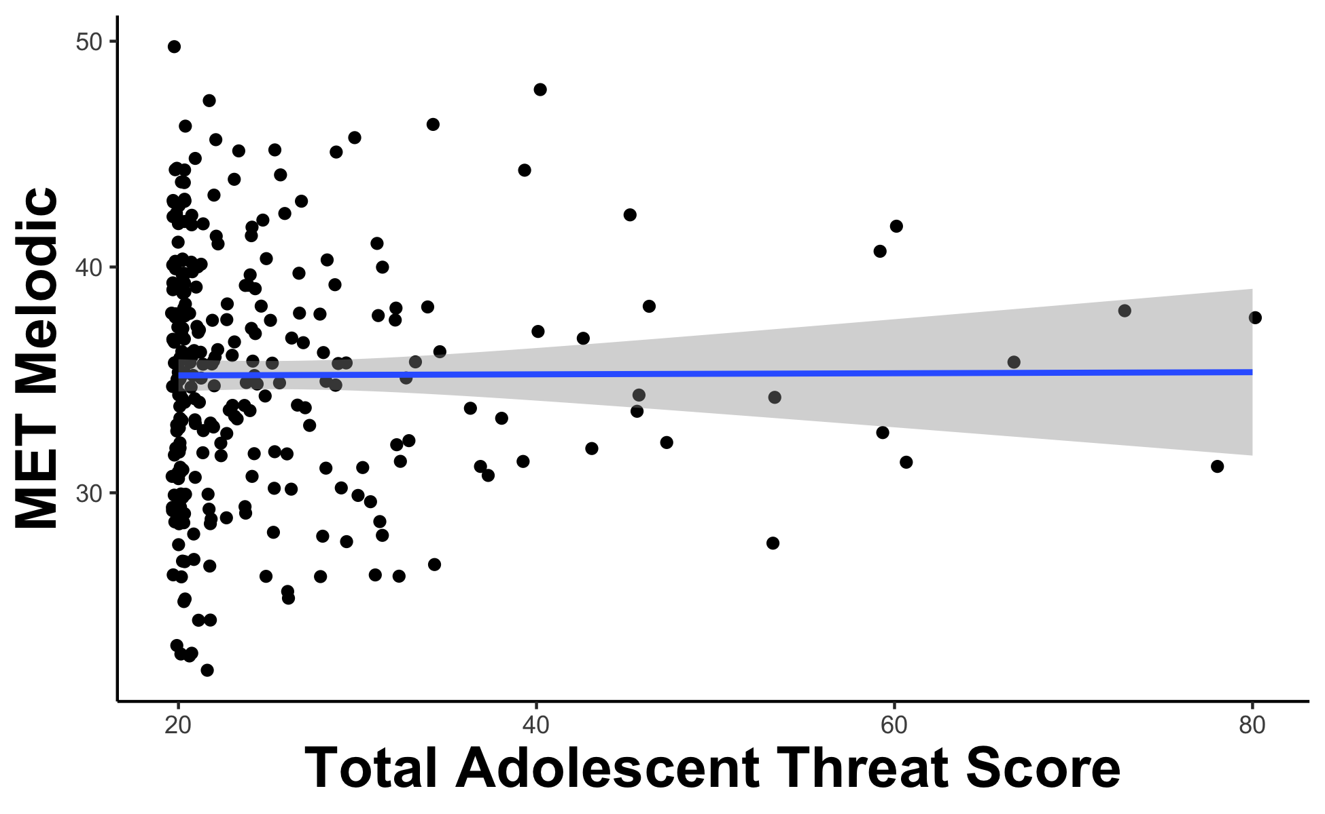
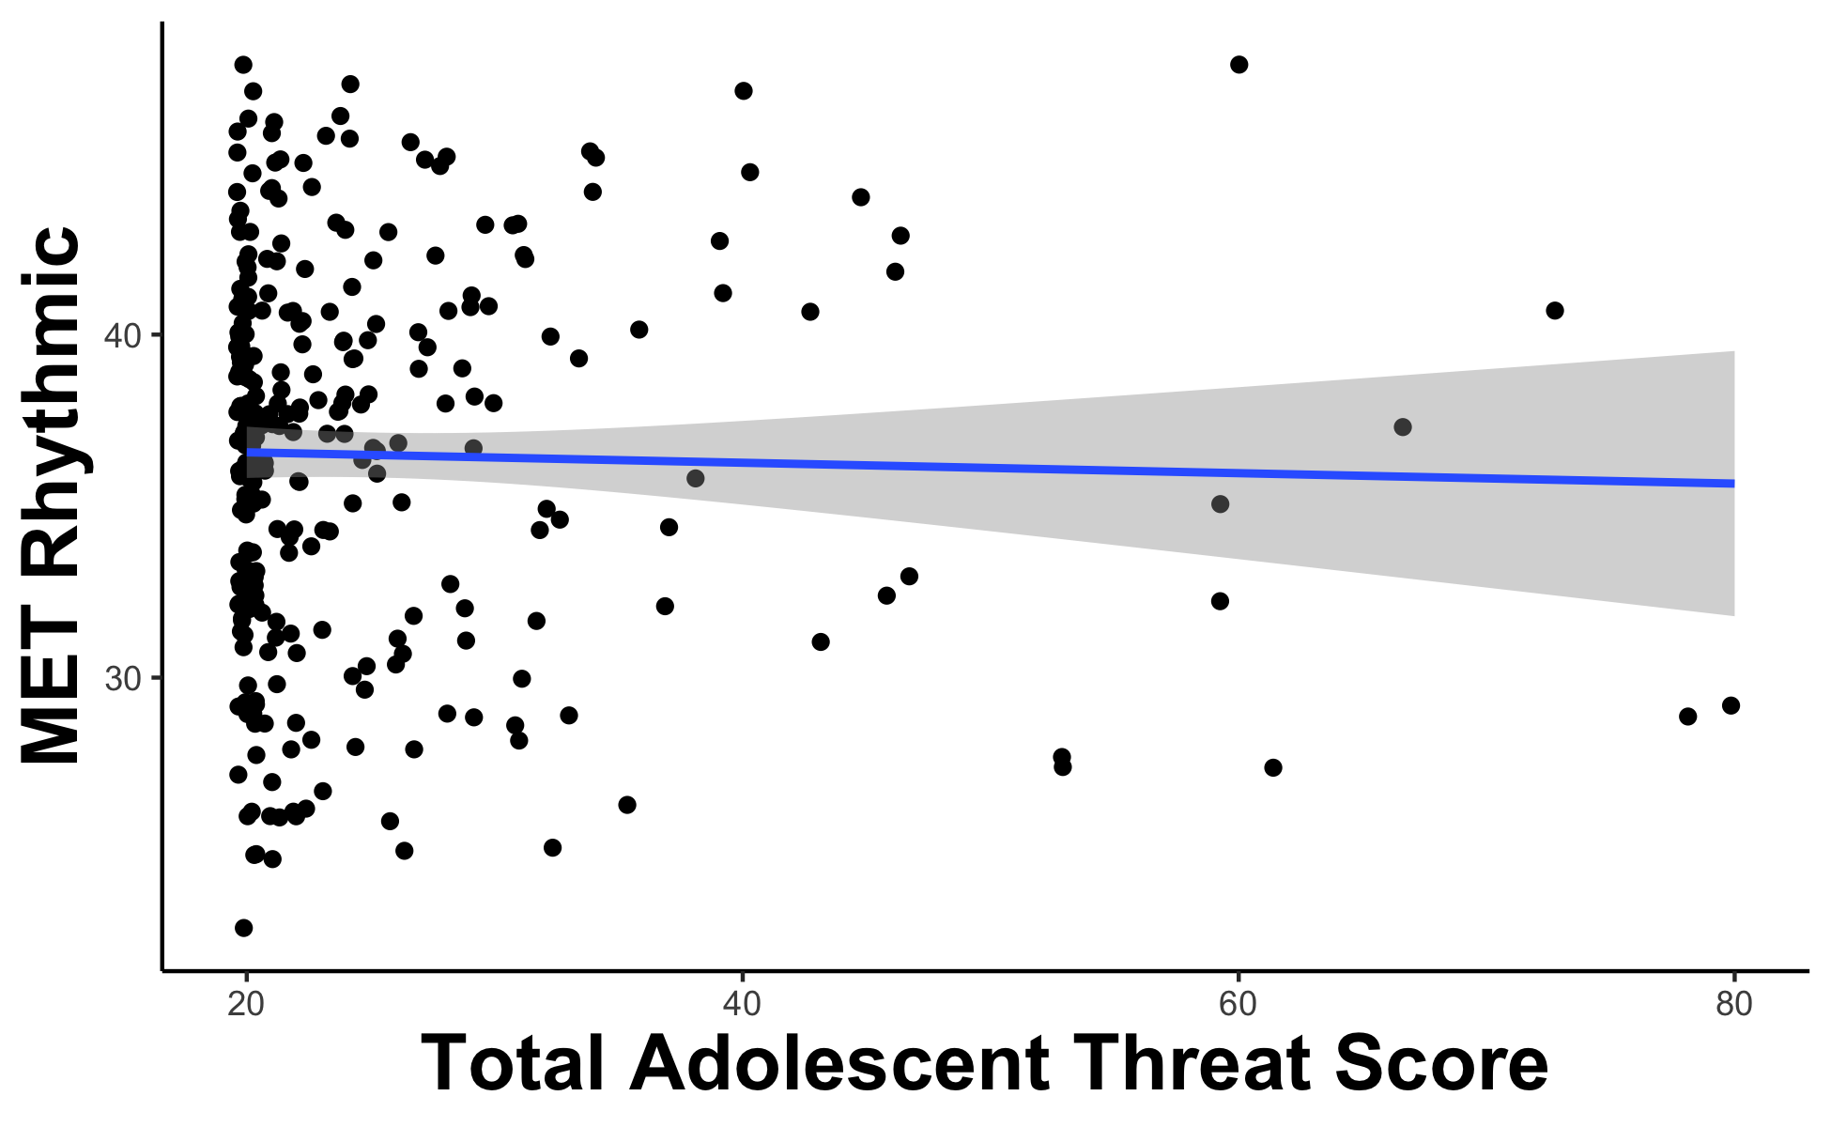
No associations between early adversity and MET scores
Notes:
Interestingly, we found no associations across any dimensions of adversity and MET melodic or rhythmic.

Slide 15


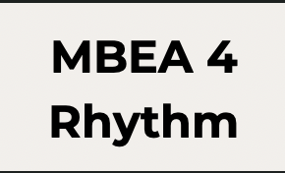
Study 3
N = 330 (150 F)
18-76 years
Montreal Battery of Evaluation of Amusia
(Peretz et al., 2003)
Notes:
Given this mixed evidence, we wanted to see whether this was a function of differences in task between the MBEA and MET. As noted, the MET is a more difficult measure of musical ability, and it's possible that the MBEA is more suited for the general population we are measuring. As a result, we conducted Study 3 with a third sample to once again administer the MBEA 1 scale test, as well as administer the MBEA 2 contour test and the MBEA 4 rhythm test.
The Contour test measures the ability of the listener to detect changes to the contour of the melody. This test alters the contour of a melody by changing one note of the melody so that its pitch height, respective to its neighboring notes, is reversed.
The Rhythm test uses the same melodies as the pitch-based tests but in the different “comparison” melodies, it is the duration of two adjacent notes that are altered, rather than the pitch of the notes.
We also administered the same adversity questionnaires, including the full 15-item CHAOS, and the state trait anxiety index, but because this was a secondary analysis we don't have all covariates, we're missing the GoldMSI and PAS, but we're currently collecting them.

Slide 16
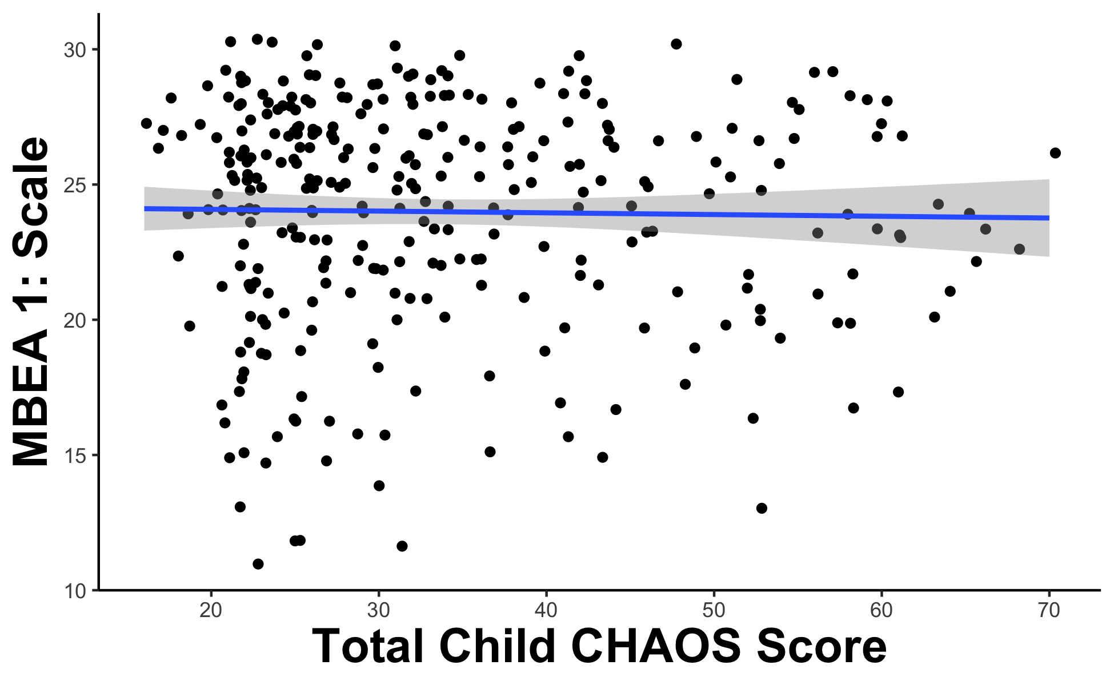
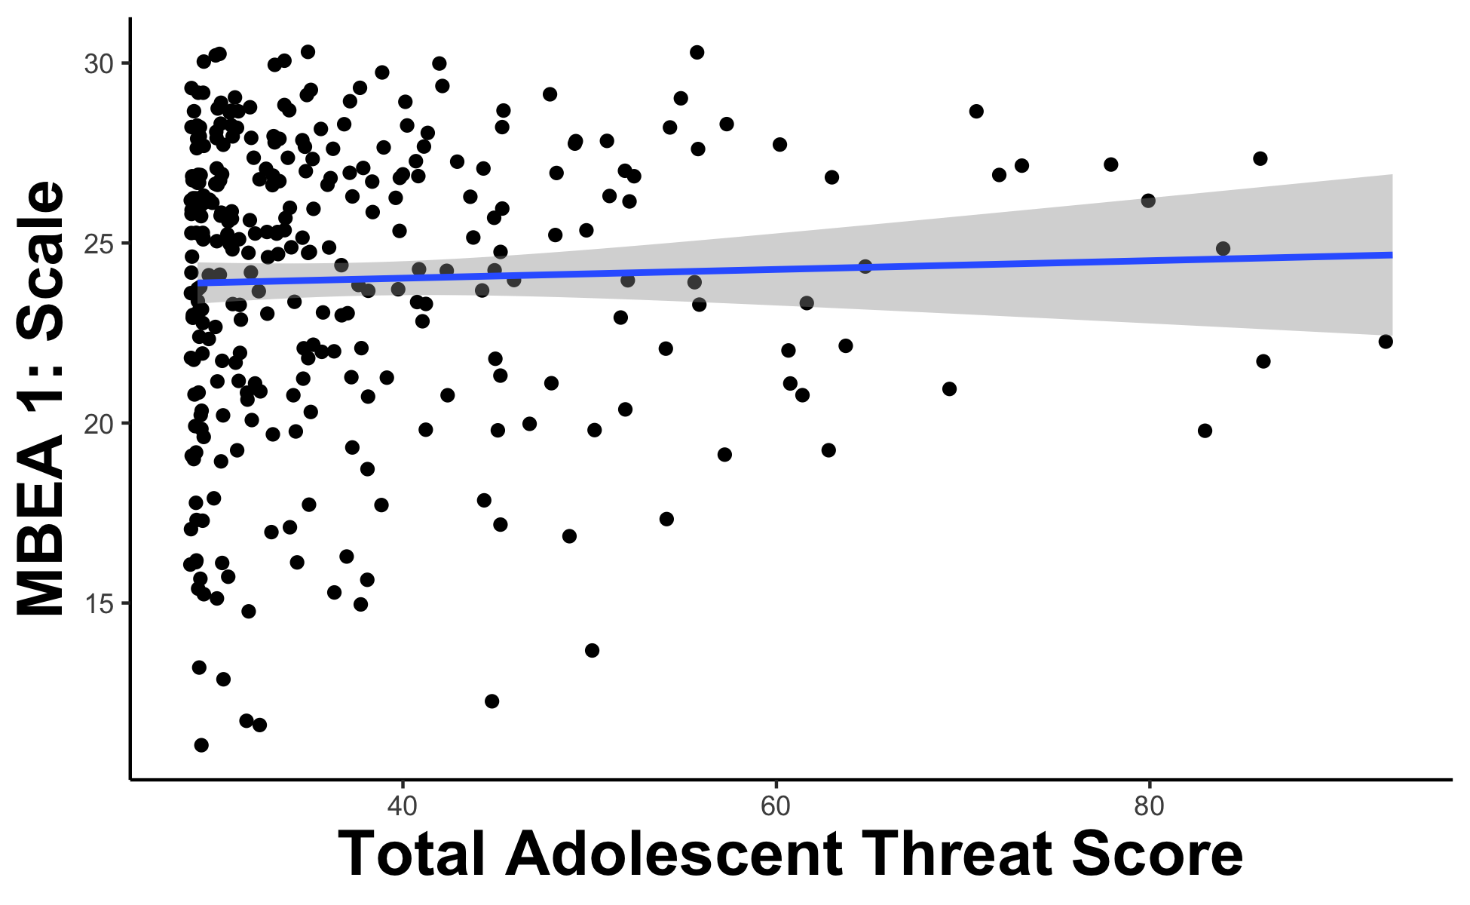
No associations between early adversity and MBEA 1 scores
Notes:
Notably, there were no associations between early adversity and MBEA 1 scores.

Slide 17
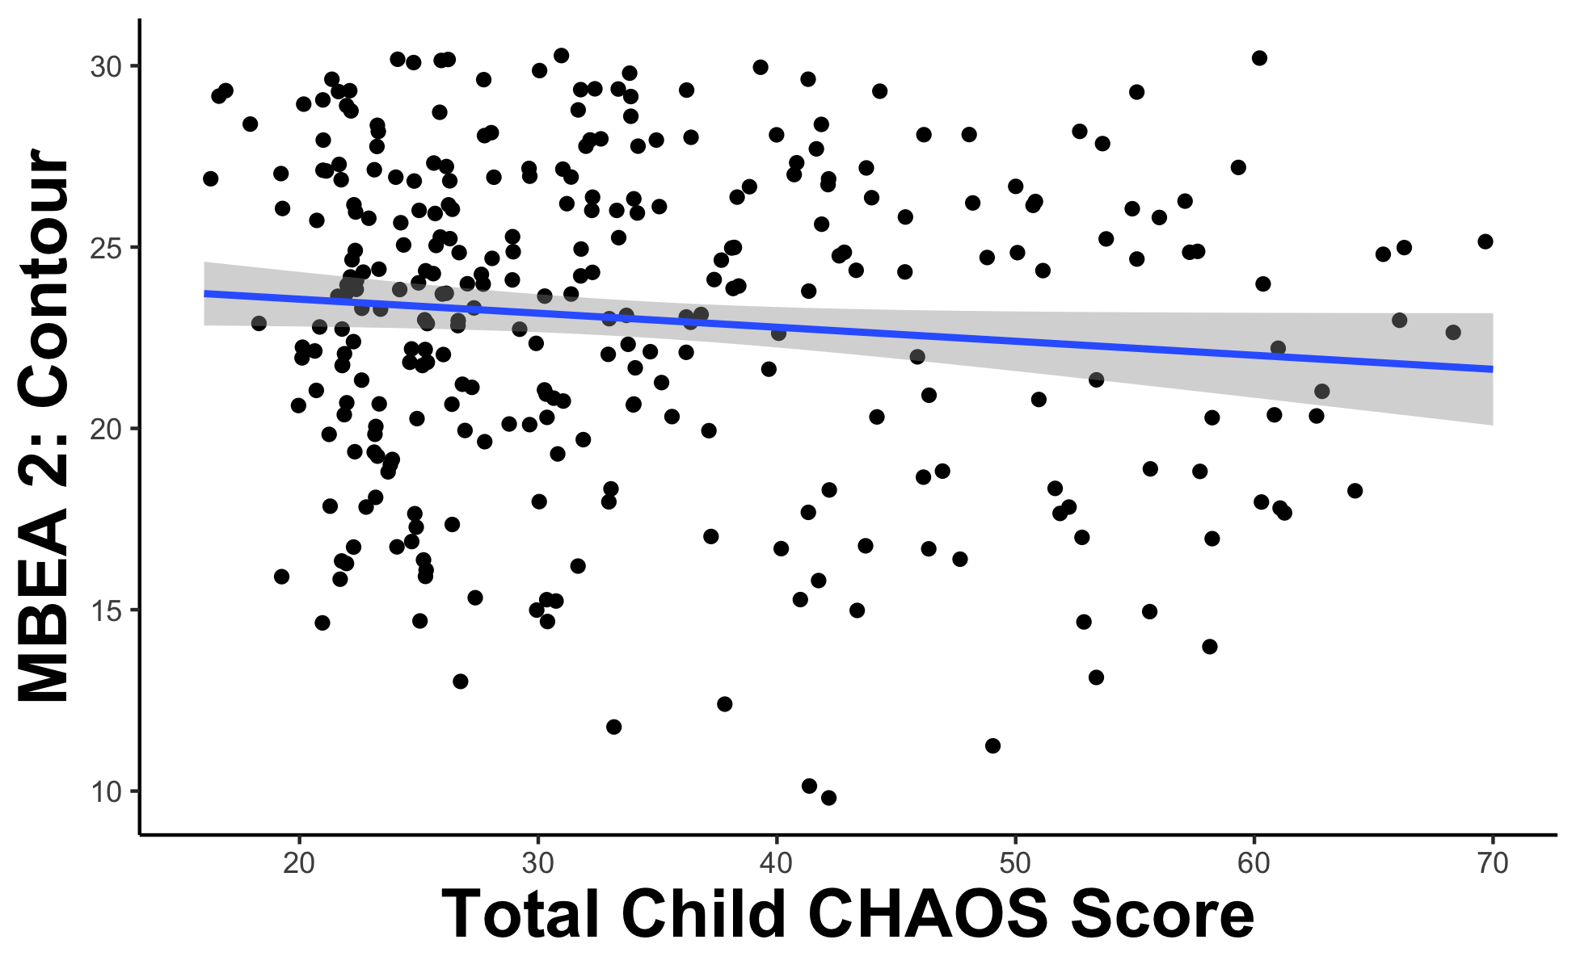
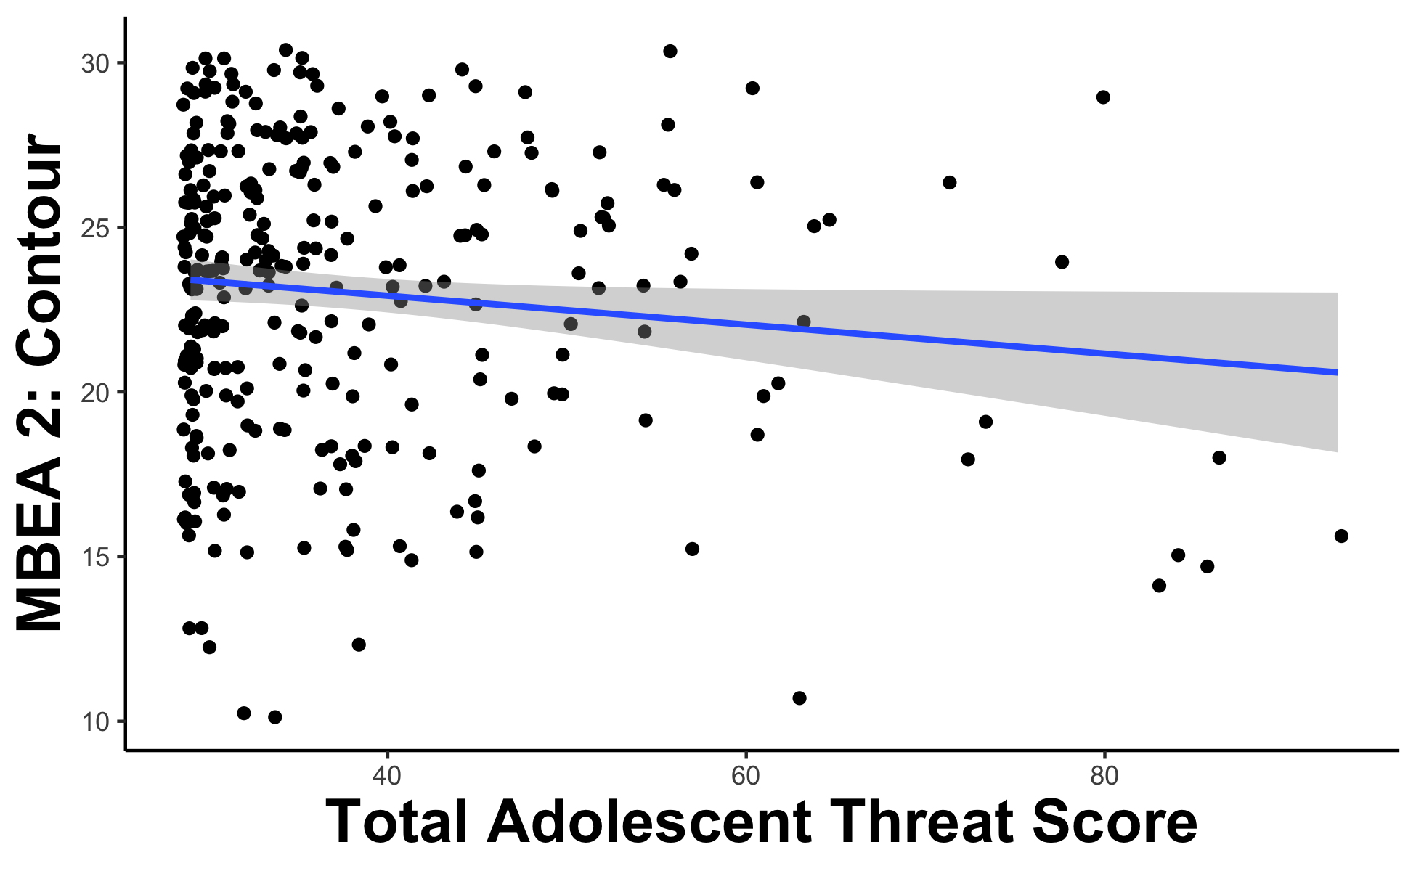
Childhood auditory commotion is marginally associated with lower MBEA 2 scores while adolescent threat is significantly associated with lower MBEA 2 scores
r = -0.11, p = .06
r = -0.12, p = .04
Notes:
However, childhood auditory commotion is marginally associated with lower MBEA 2 scores while adolescent threat is significantly associated with lower scores on MBEA 2

Slide 18
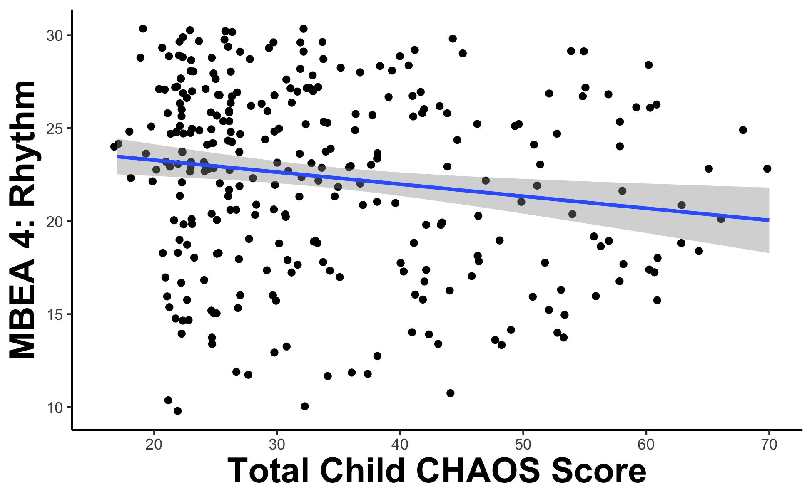
Childhood auditory commotion is associated with lower scores on MBEA 4
r = -0.16, p = .01
Notes:
Meanwhile, childhood auditory commotion is significantly associated with lower scores on MBEA 4

Slide 19
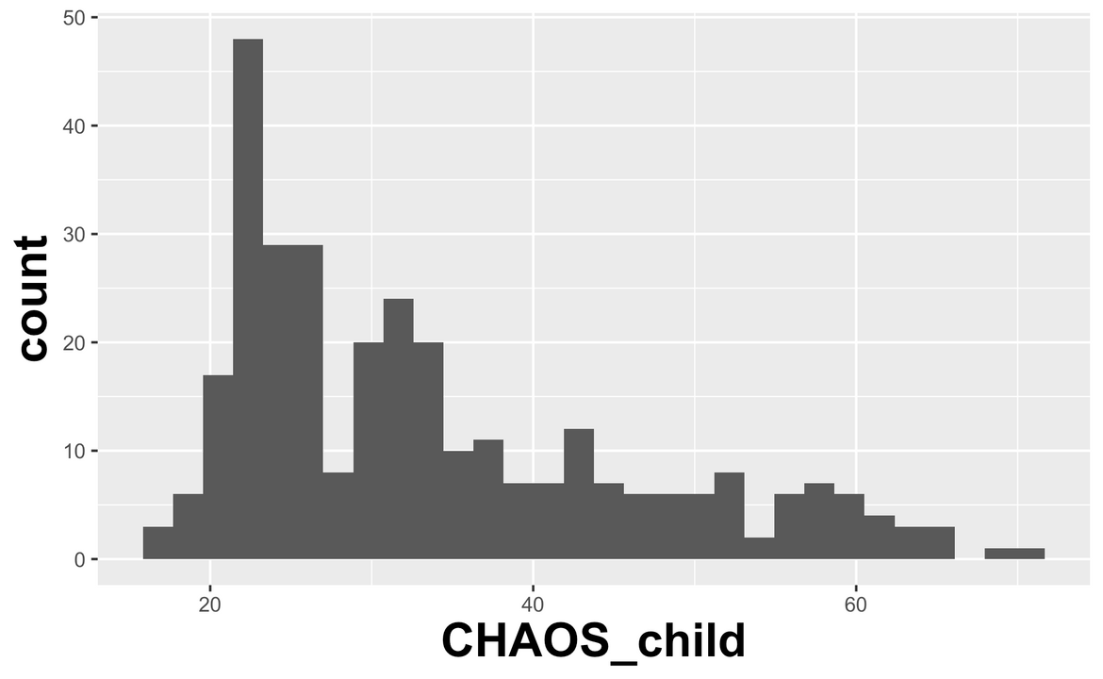
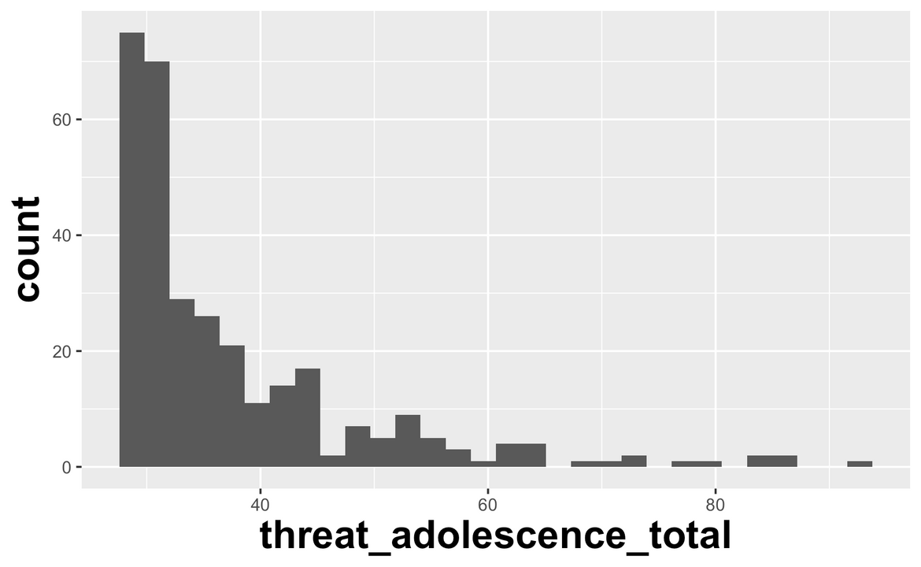
Positive Psychology
Seligman & Csikszentmihaly, 2000; Seligman, 2012
Notes:
Given we are still finding mixed evidence, we decided to turn toward inspecting our distribution of adversity scores across the samples. This is an example from sample 3. As you can see, there is some variability in the adversity scores, but it skews heavily toward low or no adversity, particularly for the dimension of threat. As mentioned, these samples were from previously collected studies in the lab and were not recruited for specifically having adversity. Given this, we began shifting our attention to the field of "positive psychology." The field of positive psychology focuses on the influence of positive experiences on outcomes, shifting away from the typical focus on adverse experiences. This is not an entirely new idea, but it has been gaining more and more traction as another dimension of the early environment to consider.

Slide 20


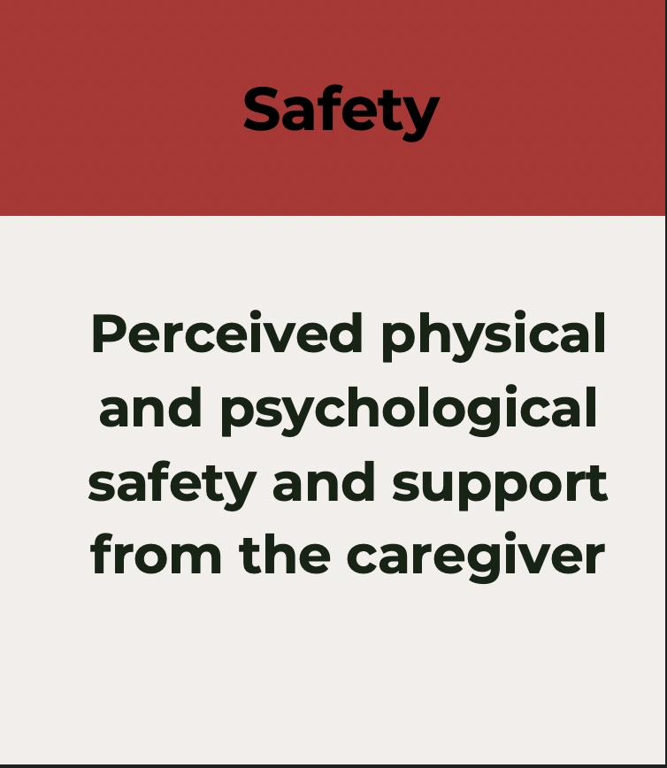
POS DEV Scale
Lopez,* Kathios,* and Gabard-Durnam (in prep)
Cognitive and affective enrichment and close emotional connections with caregiver
Perceived physical and psychological safety and support from the caregiver
Predictability of interactions with caregiver
Childhood
(6 - 12 years)
Adolescence
(13 - 18 years)
Notes:
Our lab has had a hand in this shift. Alongside my collaborator Nick Kathios on this project, we have created and validated the Predictability, Opportunity, and Safety Dimensions of Environmental Variability (POS DEV) scale to measure the influence of positive experiences in the early environment. We aimed to measure the complements of dimensions of adverse experiences through this scale. Specifically, predictability, opportunity, and safety. This questionnaire is measured retrospectively at both the childhood and adolescent time points. We administered this questionnaire to our third sample of participants to explore the effects of positive experiences on adult musicality.

Slide 21
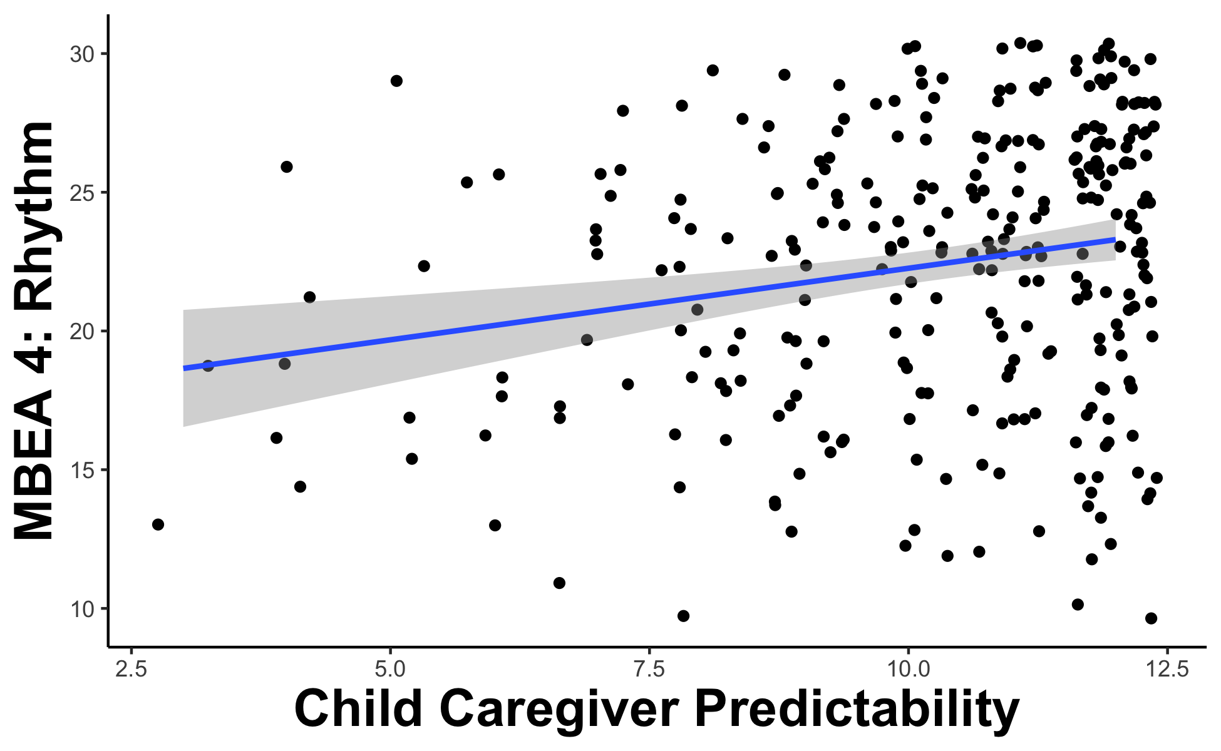
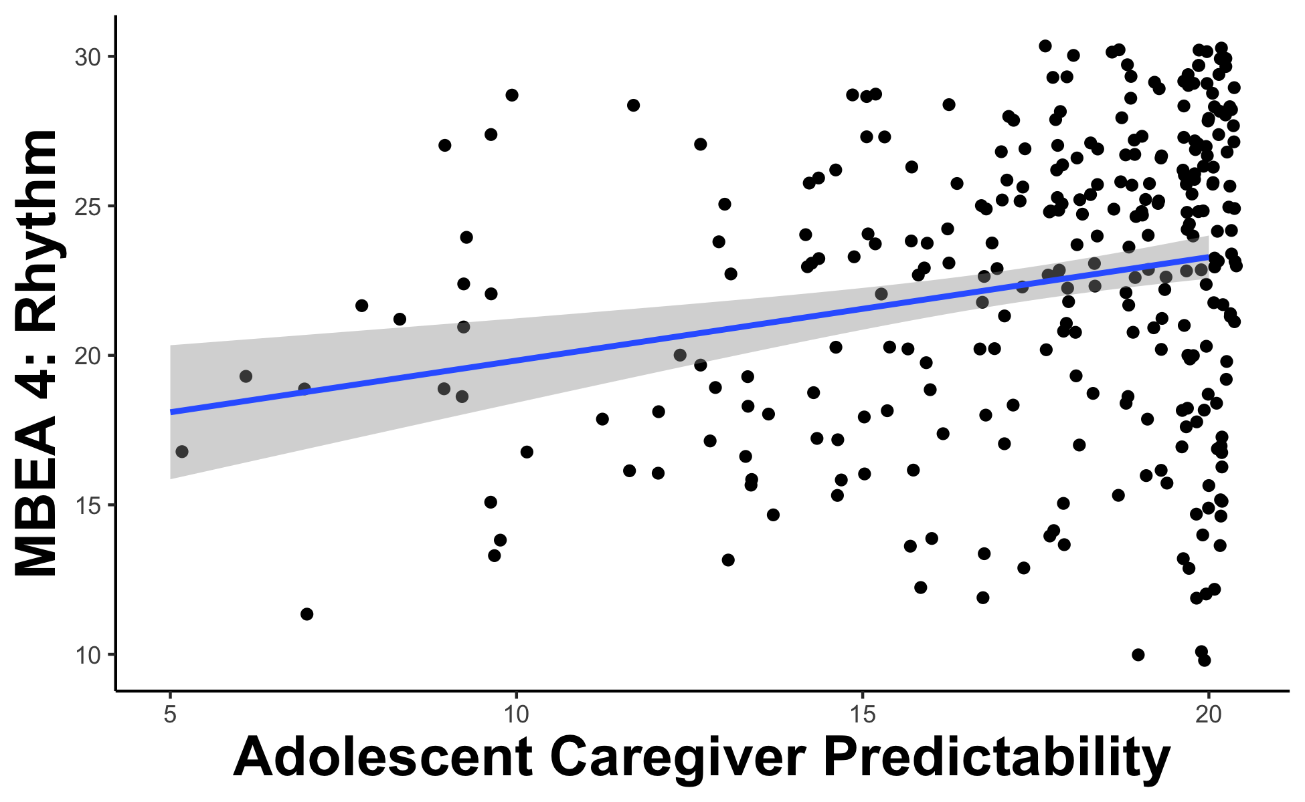
Caregiver predictability in childhood and adolescence is associated with higher scores on MBEA 4
r = 0.21, p < .001
r = 0.22, p < .001
Notes:
Because unpredictability in the form of auditory commotion was a consistent negative predictor of MBEA scores in childhood, we focused on the predictability subscale of the POS DEV scale. We found that caregiver predictability in childhood and adolescence is associated with higher scores on MBEA 4.

Slide 22
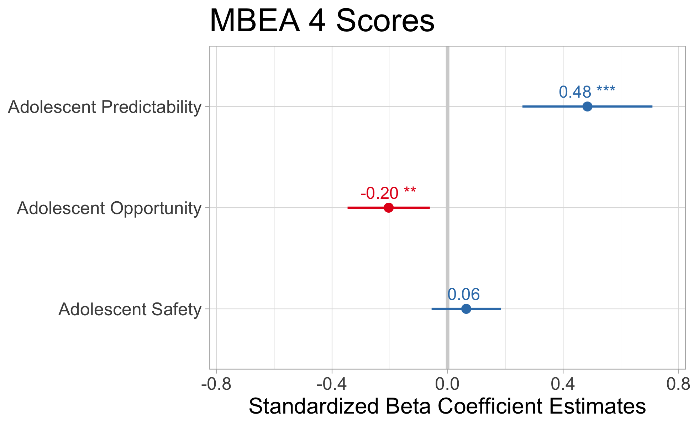
Caregiver predictability in adolescence predicts higher scores on MBEA 4 while caregiver opportunity in adolescence predicts lower scores on MBEA 4
Notes:
When accounting for the three dimensions of positive experiences in adolescence, caregiver predictability predicts higher scores on MBEA 4 while caregiver opportunity in adolescence predicts lower scores on MBEA. The association between caregiver opportunity in adolescence and lower MBEA 4 scores is surprising because much like musical training, one would expect that increased opportunity would lead to better scores. However, this is underscoring the importance of a predictable environment on later musicality.
In a model accounting for all three dimensions of positive experiences in childhood, childhood predictability continues to be the sole predictor of higher MBEA 4 scores in adulthood.

Slide 23
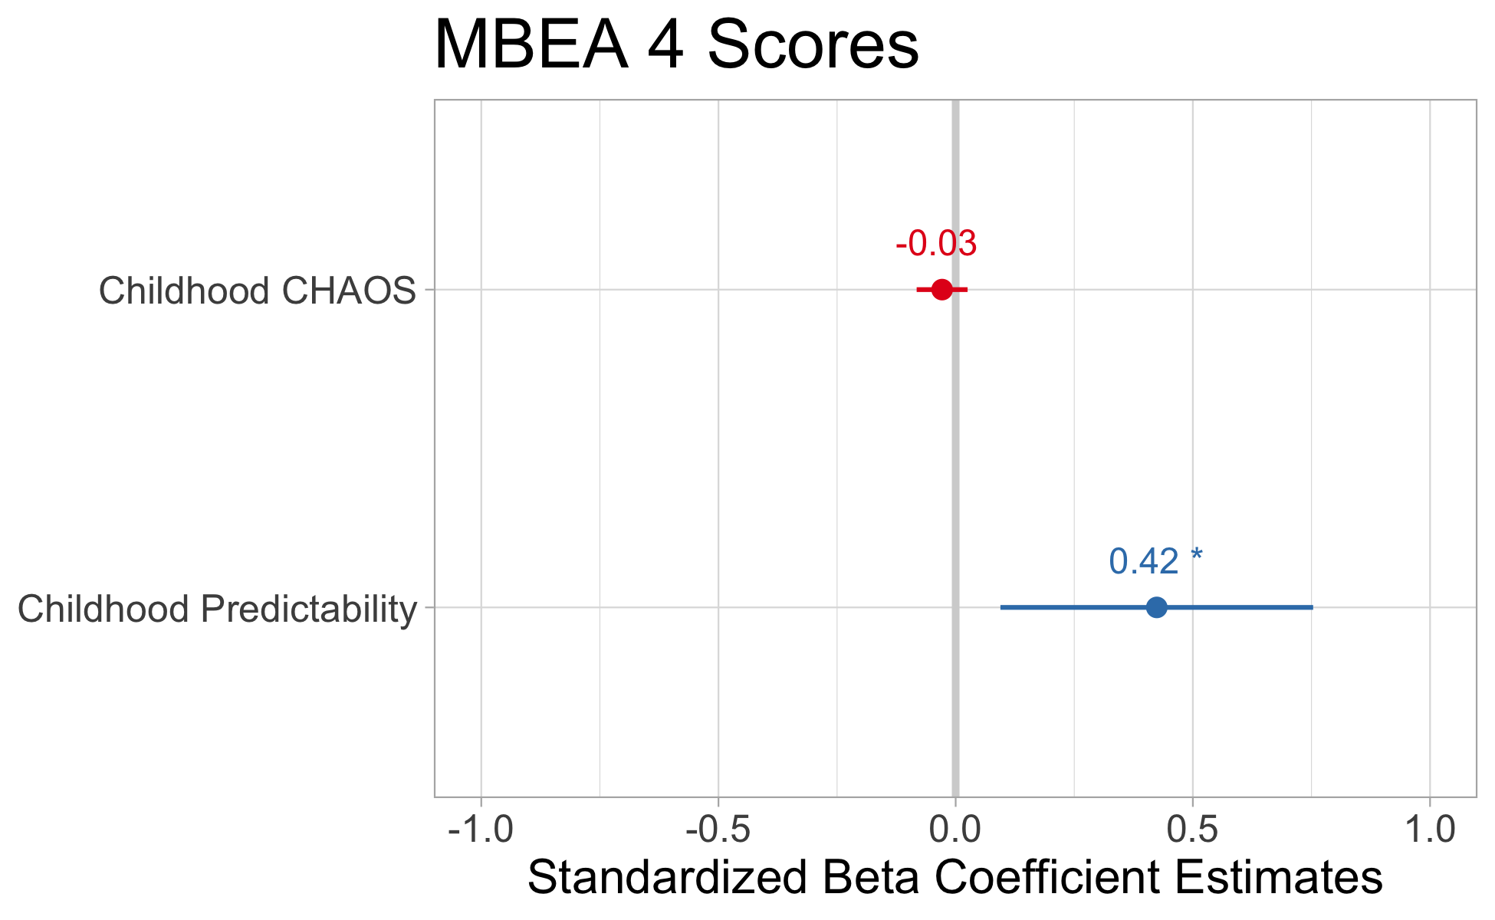
Childhood predictability predicts better MBEA 4 scores over and above childhood auditory commotion
Notes:
And for further support toward predictable caregiver environments, a model with both childhood auditory commotion and childhood predictability as predictors of MBEA 4 scores, only the positive early environment has the unique ability to predict MBEA 4 scores, confirming the importance of caregiver predictability in childhood.

Slide 24
Discussion
Provide evidence that auditory commotion in the home throughout childhood is associated with lower MBEA scores
More predictable home environment is related to long-term musicality
The early environment influences adult musicality - further research will address specific mechanisms of musicality
Notes:
Explanation from this consistent finding may be explained by the theory of predictive modeling. In predictive modeling, the brain attempts to minimize the prediction error between sensory input and top-down predictions of that input. It has been shown that we all have a predictive model while listening to music and correct prediction is inherently rewarding in music. The way the model improves is by minimizing prediction error, but if you can’t predict the environment, then there's no improvement to the predictive model. So specifically, we postulate that the increase in chaos and auditory commotion in the home environment doesn’t allow for fine tuning/precision of the predictive model, leading to downstream negative effects on musicality.
More predictable home environment is related to musicality in adulthood, over and above unpredictability in the form of auditory commotion. This is evidence that positive experiences in childhood may have far reaching effects that lead to improved musical ability inadulthood. However, follow-up analyses are planned to control for musical training and mental health outcomes in these models once data collection is complete.
And finally, I have shown you evidence today that the early environment influences adult musicality, but further research must be conducted to address the specific mechanisms of musicality that are being impacted.

Slide 25









Thank you for listening!
Thank you to collaborators on this project:
Nick Kathios
Dr. Psyche Loui
Dr. Laurel Gabard-Durnam
MIND Lab
PINE Lab
Thank you to our research funders::
NSF GRFP to Kelsie L. Lopez
NSF GRFP to Nick Kathios
Center for Cognitive and Brain Health Seed Grant
POS DEV Scale
ICMPC Travel Award

